Slide 1
Blackboard
Sergi Gonzalez Martos
Marta Sunyer Giménez

Slide 2
Introducció
CONTEXT
USOS
PROBLEMA

Slide 3
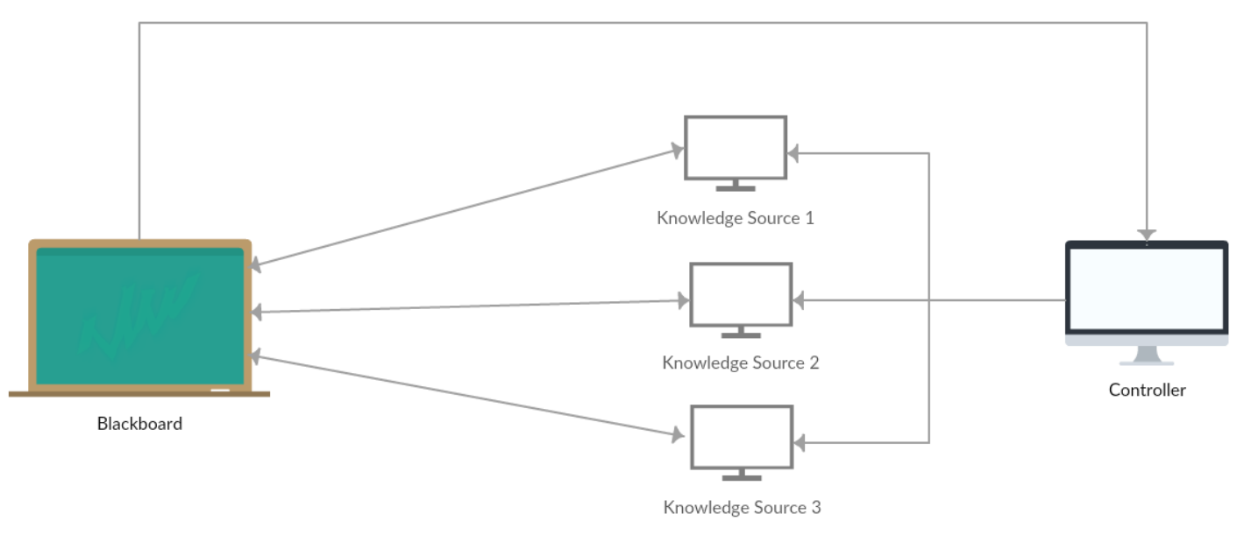
Solució

Slide 4
Avantatges
FLEXIBILITAT
PARAL·LELISME
SOLUCIONS INCREMENTALS
COMPARTICIÓ EFICIENT DE DADES

Slide 5
Inconvenients
DIFÍCIL DE TESTEJAR
QUALITAT DE LA SOLUCIÓ
COMPLEXITAT

Slide 6
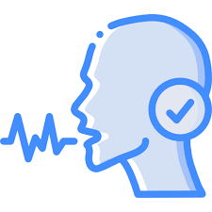
Exemple

Slide 7
Bibliografía
Lee Wei Sheng, E., Kian Lon, L., Lim Jie Yu, H., Guo Kuan Norman, Y., & Waterloo University. (2018, 18 febrero). Blackboard Architecture. https://cs.uwaterloo.ca/~m2nagapp/courses/CS446/1181/Arch_Design_Activity/Blackboard.pdf
Butler, G. & Concordia University. (s. f.). Blackboard Architecture. https://users.encs.concordia.ca/~gregb/home/PDF/soen6461_blackboard_arch.pdf
Velthuijsen, H. & Maastricht University. (1992, 1 enero). The nature and applicability of the blackboard architecture. https://cris.maastrichtuniversity.nl/ws/portalfiles/portal/802590/guid-e9f4b477-9012-4f56-ae88-aa0983ea63ac-ASSET1.0.pdf
What are the benefits of using a blackboard architecture style? (2024, 6 enero). https://www.linkedin.com/advice/3/what-benefits-using-blackboard-architecture-style-4l3yc
Design Patterns Lectures. (2020, 17 noviembre). The blackboard design pattern [Vídeo]. YouTube. https://www.youtube.com/watch?v=JyoZaxQvhmk
Archiveddocs. (2024, 17 enero). Blackboard design pattern. Microsoft Learn. https://learn.microsoft.com/en-us/archive/technet-wiki/13215.blackboard-design-pattern
Metzner, C., Cortez, L., Chacín, D., & Universidad Central de Venezuela. (s. f.). Using a Blackboard Architecture in a Web Application. https://proceedings.informingscience.org/InSITE2005/I58f73Metz.pdf
Lalanda, P. & Thomson-CSF Corporate Research Laboratory. (s. f.). Two complementary patterns to build multi-expert systems. https://hillside.net/plop/plop97/Proceedings/lalanda.pdf
Learn with Whiteboard. (2023, 19 febrero). All Major Software Architecture Patterns Explained in 7 Minutes | Meaning, Design, Models & Examples [Vídeo]. YouTube. https://www.youtube.com/watch?v=ZTVAs9cNo30

